Slide 1
Introduction to ASP.Net MVC
Course Code: CSC 4164
Course Title: ADVANCED PROGRAMMING WITH .NET
Dept. of Computer Science
Faculty of Science and Technology
Lecture No: | 04 | Week No: | 02 | Semester: | Fall 2020-21
Lecturer: | Victor Stany Rozario, stany@aiub.edu

Slide 2
Lecture Outline
Controller finding a view
Passing data from Controller to View
Models
Strongly typed views

Slide 3
Controller finding a view
The URL tells the routing mechanism which controller class to instantiate and which action method to call and supplies the required arguments to that method.
The controller’s method then decides which view to use, and that view then renders the HTML.
The Views directory contains a folder for your controller, with the same name as the controller.
Within controller folder there’s a view file for each action method, named the same as the action method.
This is how views are associated to an action method.

Slide 4
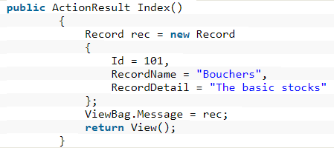
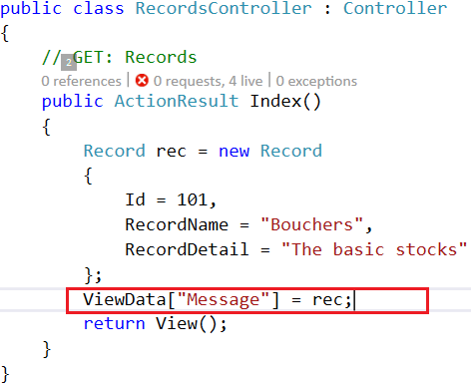
Passing data from Controller to View
ViewBag: Is a type object and a dynamic property under the controller base class.
It is ideally temporary data.
It doesn’t have typecasting and null checks.
ViewData: Is a dictionary which can contain key-value pairs where each key must be string. Requires typecasting as well as null checks.

Slide 5
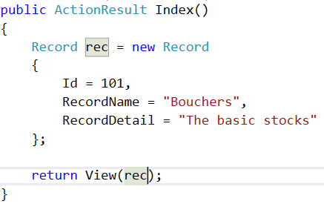
Passing an object of the model class to the View.
TempData: Stays for a subsequent HTTP Request as opposed to other options (ViewBag and ViewData) those stay only for current request.
Maintain data between controller actions as well as redirects.
Typecasting and null checks required in order to avoid errors.
public ActionResult TemporaryEmployee()
{
Employee employee = new Employee
{
EmpID = “121”,
EmpFirstName = “John”,
EmpLastName = “Nguyen”
};
TempData[“Employee”] = employee;
return RedirectToAction(“PermanentEmployee”);
}

Slide 6
Models
What is Model?
Business/domain logic
Model objects, retrieve and store model state in a persistent storage (database).
public class Customer{
public string FirstName { get; set; } public string LastName { get; set; } public string Company { get; set; } public IEnumerable Orders { get; set; }
}

Slide 7
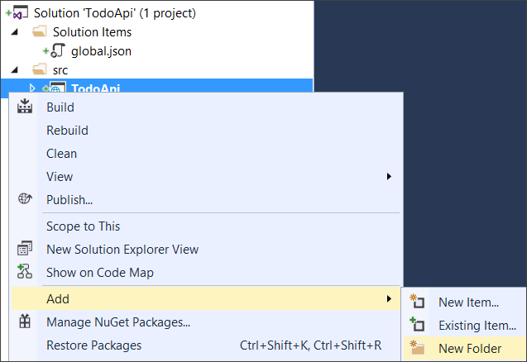
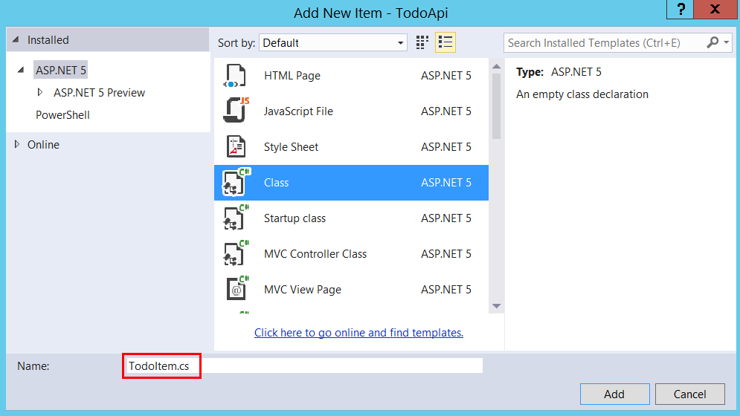
Creating Models
Add a folder named “Models”. In Solution Explorer, right-click the project. Select Add → New Folder. Name the folder Models.
Right-click the Models folder and select Add → New Item. In Add New Item, select the Class. Name the class TodoItem and click OK.
publicclassTodoItem
{
public string Key { get; set; }
public string Name { get; set; }
public bool IsComplete { get; set; }
}

Slide 8
Strongly typed views
The view which binds to a specific type of View Model by passing the model object as a parameter to the View() method is called as Strongly Typed View.
public class HomeController : Controller
{
public ActionResult Index()
{
EmployeeBusinessLayer employeeBL = new EmployeeBusinessLayer();
Employee employee = employeeBL.GetEmployeeDetails(101);
ViewBag.Header = "Employee Details";
return View(employee);
}
}

Slide 9
Changes in Index.cshtml View:
@model FirstMVCDemo.Models.Employee
<!DOCTYPE html>
<html>
<head>
<meta name="viewport" content="width=device-width" />
<title>Page Title</title>
</head>
<body>
<h2>@ViewBag.Header</h2>
<table style="font-family:Arial">
<tr>
<td>Employee ID:</td>
<td>@Model.EmployeeId </td>
</tr>
<tr>
<td>Name:</td>
<td>@Model.Name</td>
</tr> </table>
</body>
</html>
Advantages of Strongly-typed views:
Strongly Typed View in ASP.NET MVC provides compile-time error checking as well as intelligence support.
If we misspell the property name, then it comes to know at compile time rather than at runtime.

Slide 10
Books
Beginning ASP.NET 4: in C# and VB; Imar Spaanjaars,2010
Beginning ASP.NET 3.5 in C# 2008: From Novice to Professional; 2nd edition, Matthew MacDonald,2007
ASP.NET 3.5 Unleashed by Stephen Walther, 2008
Pro ASP.NET 3.5 in C# 2008: Includes Silverlight 2 by Matthew MacDonald,2008
ASP.NET 3.5 For Dummies by Ken Cox,2008

Slide 11
References
ASP.NET; URL: https://dotnet.microsoft.com/apps/aspnet
URL: https://www. tutorialspoint.com/index.htm
URL: http://www.webdevelopmenthelp.net/2014
View Engines; URL: https://www.tutorialride.com/asp-net-mvc
URL: https://www.tutorialsteacher.com/mvc
Strongly typed views; URL: https://dotnettutorials.net/lesson

Slide 12
Thank you!

